Slide 1
MSDS 6306 Case Study 1
David Shaw
Justin Castro

Slide 2
Breweries by State
Most breweries located in California and Colorado
At least one in every single state, including DC

Slide 3
Alcohol and Bitterness Measure by State

Slide 4
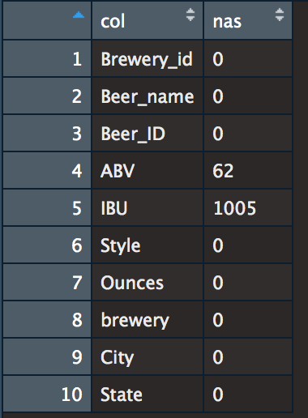
Outliers and Missing Values
No significant outliers were detected
62 missing values for ABV, 1005 for IBU

